Slide 1
Turing acceptable languages and
Enumerators
Costas Busch - LSU

Slide 2
We will prove:
(weak result)
If a language is decidable then
there is an enumerator for it
(strong result)
A language is Turing-acceptable
if and only if
there is an enumerator for it
Costas Busch - LSU

Slide 3


Theorem:
if a language is decidable then
there is an enumerator for it
Proof:
Let be the decider for
Use to build the enumerator for
Costas Busch - LSU

Slide 4





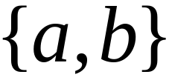




Let be an enumerator that prints
all strings from input alphabet in proper order
Example:
alphabet is
(proper order)
Costas Busch - LSU

Slide 5



Enumerator for
Repeat:
1. generates a string
2. checks if
YES: print to output
NO: ignore
This part terminates,
because is decidable
Costas Busch - LSU

Slide 6

Enumerator for
Give me
next string
Enumerates all
strings of
input alphabet
output
If accepts
then print to
output
string
All strings
of
Generates all
Strings in alphabet
Tests each string
if it is accepted by
Costas Busch - LSU

Slide 7
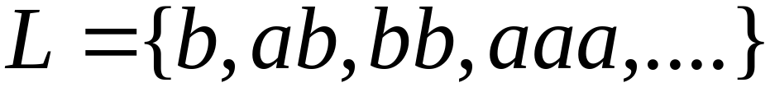




Example:
Enumeration
Output
reject
accept
reject
accept
reject
accept
accept
reject
END OF PROOF
Costas Busch - LSU

Slide 8

Theorem:
if language is Turing-Acceptable then
there is an enumerator for it
Proof:
Let be the Turing machine that accepts
Use to build the enumerator for
Costas Busch - LSU

Slide 9

Enumerator for
Enumerates all
strings of input alphabet
in proper order
Accepts
Costas Busch - LSU

Slide 10

NAIVE APPROACH
Enumerator for
Repeat:
generates a string
checks if
YES: print to output
NO: ignore
Problem:
If
machine may loop forever
Costas Busch - LSU

Slide 11

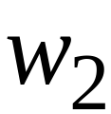
BETTER APPROACH
Generates first string
executes first step on
Generates second string
executes first step on
second step on
Costas Busch - LSU

Slide 12
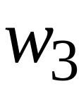
Generates third string
executes first step on
second step on
third step on
And so on............
Costas Busch - LSU

Slide 13
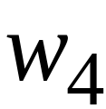
String:
1
1
1
1
Step in
computation
of string
2
2
2
2
3
3
3
3
4
4
4
4
Costas Busch - LSU

Slide 14

If for any string
machine halts in an accepting state
then print on the output
End of Proof
Costas Busch - LSU

Slide 15
Theorem:
If for language
there is an enumerator
then is Turing-Acceptable
Proof:
Using the enumerator for
we will build a Turing machine
that accepts
Costas Busch - LSU

Slide 16
Input Tape
Turing Machine that accepts
Enumerator
for
Compare
If same,
Accept and Halt
Give me the
next string
in the
enumeration
sequence
Costas Busch - LSU

Slide 17
Turing machine that accepts
For any input string
Loop:
Using the enumerator of ,
generate the next string of
Compare generated string with
If same, accept and exit loop
End of Proof
Costas Busch - LSU

Slide 18
By combining the last two theorems,
we have proven:
A language is Turing-Acceptable
if and only if
there is an enumerator for it
Costas Busch - LSU

